Slide 1
MINI PROJECT
Name | Adithya Rao Kalathur, Vaishnav PS, Sriram K, Vaibhav V acharya
Registration Numbers | 251100610012 | 251100610013 | 251100610017 | 251100610040
Branch | M.E. Computer Science and Engineering
Project Title | Development of Deep Learning Approach for Grading Squamous Cell Carcinoma from Histopathology Images
Guide | Dr Keerthana Prasad

Slide 2
CONTENTS
Introduction
Literature Review
Objective
Operational Flow
Implementation & Work Done
Results
Conclusions
Further Work
References

Slide 3
INTRODUCTION
Squamous Cell Carcinoma (SCC) arises from squamous epithelial cells which are flat cells found on skin, mouth, and internal organs.
SCC is a common type of cancer, and its accurate grading from histopathology images is crucial for determining prognosis and treatment plans.
Manual grading faces several challenges, including the need for high expertise and focus, inconsistencies caused by variations in image quality, and delays or fatigue resulting from heavy hospital workloads, all of which point to a clear need for automated, objective, and faster grading systems.
By leveraging Convolutional Neural Networks (CNNs), this Deep Learning method aims to analyze the intricate architectural and cellular patterns within the histopathology images, ultimately providing an objective, efficient, and consistent system for SCC grading.

Slide 4
LITERATURE REVIEW
Paper Title | Authors | Dataset | Methods/Models Used | Key Findings/Results
LungCarcinoGrade-EffNetSVM: A Novel Approach to Lung Carcinoma Grading | Pragati Patharia, Prabira Kumar Sethy | Kaggle CT scan dataset (1,000 images) | EfficientNetB0 + SVM (one-vs-all ECOC strategy) | Accuracy: 86.88%, Sensitivity: 86.88%, Specificity: 95.63%, F1 score: 86.64%.
Squamous Cell Carcinoma Margin Classification Using Vision Transformers | So-Yun Park, Gelan Ayana, Se-woon Choe | 828 histopathological images (margin-negative/positive) | Vision Transformer (ViT) models + Dense layers | ViT-B16 achieved 0.906 accuracy & 0.905 AUC, outperforming CNN; highlights ViTs’ superiority.
A lightweight deep learning model with knowledge distillation for pulmonary diseases detection in chest X-rays | Mohammed A. Asham, Asma A. Al-Shargabi, Raeed Al-Sabri, Ibrahim Meftah | Diverse datasets covering various chest infections, including: pneumonia, COVID-19, tuberculosis | A novel lightweight student model, based on MobileNet and featuring a ConvMixer block, was trained using Knowledge Distillation (KD) | The model achieved a high 97.92% classification accuracy with a minimal 0.63 million parameter count,
EsccNet: A Hybrid CNN and Transformers Model for Classification of Esophageal SCC | Zhaoxin Kang, Mingqiu Chen, et al. | Esophageal SCC whole slide images | Hybrid CNN + Transformer | Outperformed standard CNNs; effective for whole slide image classification.

Slide 5
OBJECTIVE
Develop and evaluate deep learning models for grading Squamous Cell Carcinoma (SCC) using histopathology images.
Design and compare architectures such as DenseNet, ConvNeXt, MobileNetV2, and Inception.
Apply hyperparameter tuning by adjusting learning rate, batch size, epochs, optimizers, and activation functions.
Train, validate, and evaluate models using accuracy, precision, recall, and F1-score to determine the most reliable and consistent model.

Slide 6
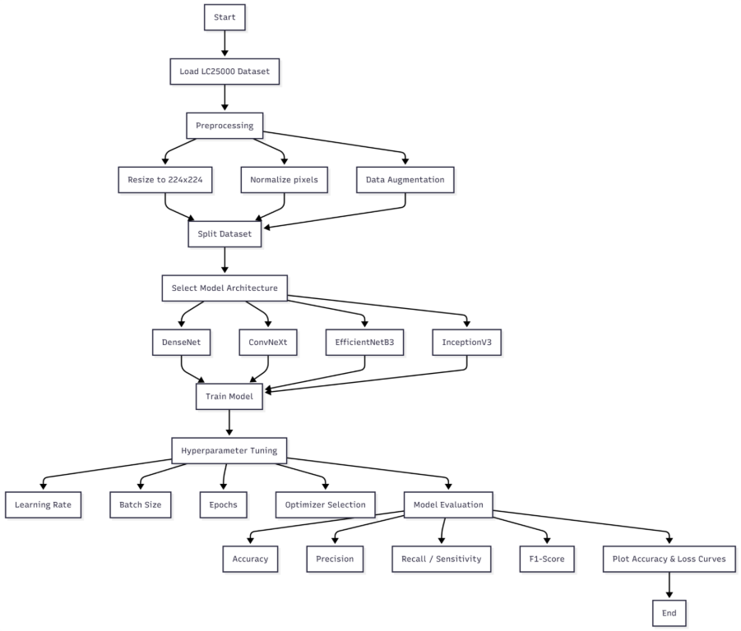
OPERATIONAL FLOW
MobileNetV2
Fig 1 Flowchart of the proposed deep learning workflow for binary classification of histopathology images

Slide 7
OPERATIONAL FLOW
Workflow Steps
  Dataset Collection
    Import the LC25000 dataset.
    Select relevant classes — Adenocarcinoma and Squamous Cell Carcinoma.
Preprocessing
    Resize images (224×224) and 300x300, normalize pixel values.
Dataset Splitting
    Divide data into training, validation, and test sets.
Model Development
    Use deep learning models — DenseNet, ConvNeXt, MobileNetV2, and InceptionV3.
    Employ transfer learning and fine-tuning.
Training & Validation
    Train models on training data.
    Validate during training using performance checkpoints.
Evaluation
    Test trained models on unseen data.
    Assess using accuracy, precision, recall, and F1-score.
    Compare results to identify the best-performing model.

Slide 8
IMPLEMENTATION &WORK DONE
Dataset & Preprocessing
Dataset Preparation & Cleaning
  LC25000 histopathology dataset used.
  Selected classes: Adenocarcinoma and Squamous Cell Carcinoma.
  Manual cleaning: Removed poor-quality images, excessive whitespace, or irrelevant structures.
Preprocessing Steps
  Resizing: 224×224 pixels
  Normalization: Pixel values scaled 0–1
Dataset Splitting
  Training, Validation, Test sets
  Helps models learn, validate, and generalize

Slide 9
IMPLEMENTATION &WORK DONE
Model Implementation & Training
Models Used
  DenseNet, ConvNeXt, MobileNetV2, InceptionV3
  Trained using GPU acceleration in Google Colab
Hyperparameter Tuning
  Learning Rate: 0.001, 0.0001, 0.0005
  Batch Size: 16, 32
  Epochs: 50, 75, 100
  Optimizers: Adam, SGD, RMSProp, AdamW
  Dropout Rates: 0.2, 0.3,0.4,0.5
Monitoring
  Training & validation accuracy and loss curves plotted for all experiments
  Used to track progress and detect overfitting

Slide 10
IMPLEMENTATION &WORK DONE
Model 1-InceptionV3
Dataset & Preprocessing
  LC25000: lung_aca & lung_scc
  Manual cleaning, resized 299×299, normalized
Model Architecture
  Pretrained InceptionV3 (ImageNet)
  Global Avg Pooling → Dense(512, ReLU) + Dropout(0.5) → Sigmoid output
Training
  Optimizers: Adam & RMSprop (LR=1e-4)
  Loss: Binary cross-entropy; Metric: Accuracy
  5-fold cross-validation
  Callbacks: EarlyStopping & ReduceLROnPlateau
Evaluation
  Confusion matrices, ROC curves, AUC
  Training/validation accuracy & loss tracked

Slide 11
RESULTS
Model 1-InceptionV3
InceptionV3 Performance (Adam Optimizer)
Dataset & Setup
  LC25000: 9,810 images (lung_aca & lung_scc)
  Image size: 299×299, batch size: 32
  Dropout: 0.5, Optimizer: Adam, LR=1e-4
Overall Performance
  Mean Validation Accuracy: 99.72% ±0.17%
  Best Accuracy: 99.85% (Fold 5)
  Lowest Accuracy: 99.39% (Fold 2)
  AUC: >0.999 for all folds
  Very few misclassifications (1–4 images/fold)
Table 1: Performance Summary (Adam Optimizer)
Metric | Value
Mean Validation Accuracy | 99.72%
Standard Deviation | ±0.17%
Best Accuracy | 99.85% (Fold 5)
Lowest Accuracy | 99.39% (Fold 2)
Total Images Used | 9,810

Slide 12
RESULTS
Training Behavior​
  Fast initial learning: Epoch 1 → Training ~87%, Validation ~96%​
  Steady improvement: Epochs 2–20 → Validation >99%​
  Fine-tuning: Epochs 20–40 with ReduceLROnPlateau​
  Early stopping triggered: Epochs 29–50​
Key Observations​
  Consistent & Stable: Low std deviation (0.17%)​
  No Overfitting: Validation accuracy ~ Training accuracy​
  Fast Convergence: High accuracy within 20–40 epochs​
  Efficient: Training ~35–40 min per fold, fast inference​
Table 2: Detailed Results per Fold (Adam Optimizer)
Fold | Validation Accuracy | Best Epoch | Total Epochs Trained | Final Learning Rate
1 | 99.80% | 40 | 50 | 2.50×10⁻⁵
2 | 99.39% | 19 | 29 | 2.50×10⁻⁵
3 | 99.80% | 39 | 49 | 5.00×10⁻⁵
4 | 99.80% | 39 | 49 | 5.00×10⁻⁵
5 | 99.85% | 35 | 45 | 2.50×10⁻⁵

Slide 13
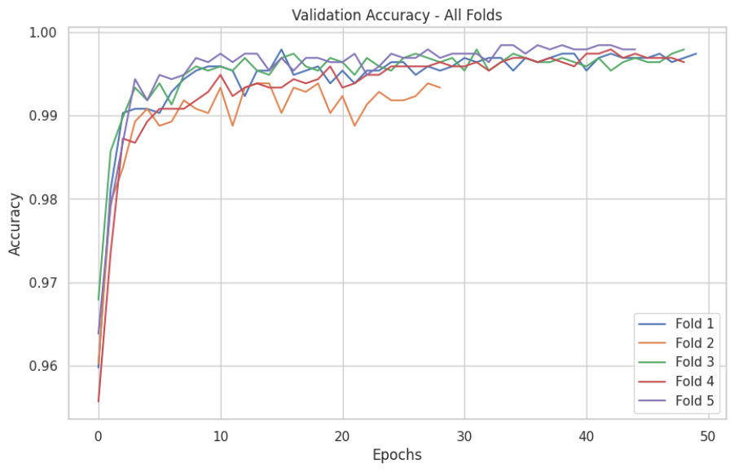
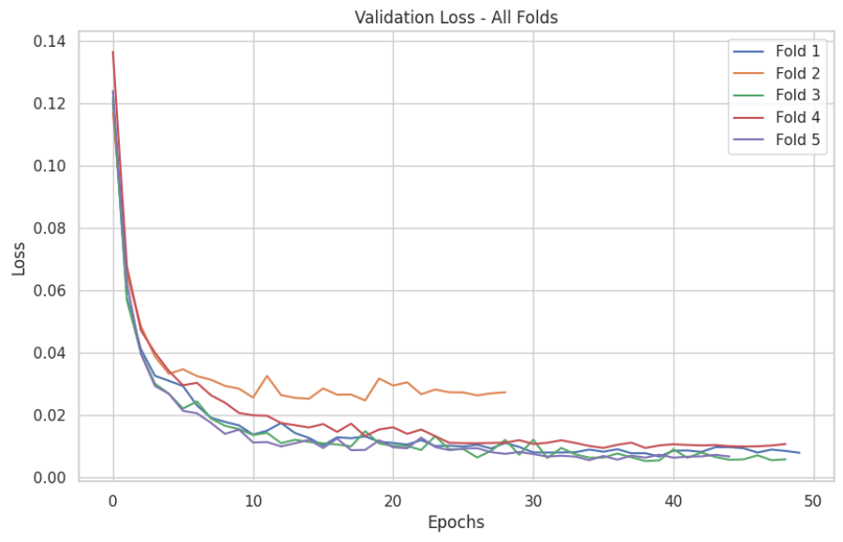
RESULTS
Fig 2. Validation Accuracy and Loss Curves Of All Folds for InceptionV3 with Adam Optimizer

Slide 14
RESULTS
InceptionV3 Performance (RMSprop Optimizer)
Dataset & Setup
  LC25000: 9,810 images (lung_aca & lung_scc)
  Image size: 299×299, batch size: 32
  Dropout: 0.5, Optimizer: RMSprop (LR=1e-4, rho=0.9)
Overall Performance
  Mean Validation Accuracy: 99.66% ±0.11%
  Best Accuracy: 99.80% (Fold 2)
  Lowest Accuracy: 99.49% (Fold 3)
  AUC: >0.999 for all folds
  Few misclassifications (4–10 images/fold)
Table 3: Performance Summary (RMSprop Optimizer)
Metric | Value
Mean Validation Accuracy | 99.66%
Standard Deviation | ±0.11%
Best Accuracy | 99.80% (Fold 2)
Lowest Accuracy | 99.49% (Fold 3)
Total Images Used | 9,810

Slide 15
RESULTS
Table 4: Detailed Results per Fold (RMSprop Optimizer)
Fold | Validation Accuracy | Best Epoch | Total Epochs Trained | Final Learning Rate
1 | 99.59% | 10 | 20 | 2.50×10⁻⁵
2 | 99.80% | 42 | 52 | 3.13×10⁻⁶
3 | 99.49% | 46 | 56 | 3.13×10⁻⁶
4 | 99.69% | 25 | 35 | 2.50×10⁻⁵
5 | 99.75% | 19 | 29 | 2.50×10⁻⁵
Training Behavior​
  Fast initial learning: Epoch 1 → Training ~87–88%, Validation ~95–97%​
  Steady improvement: Epochs 2–20 → Validation >99%​
  Fine-tuning: Epochs 20–50 with ReduceLROnPlateau​
  Early stopping triggered: Epochs 20–56​
  Validation loss decreased consistently; no overfitting​
Key Observations​
  Highly consistent: Std dev 0.11% across folds​
  Fast convergence: High accuracy within 10–46 epochs​
  Reliable & efficient: Training ~38–40 min/fold, fast inference

Slide 16
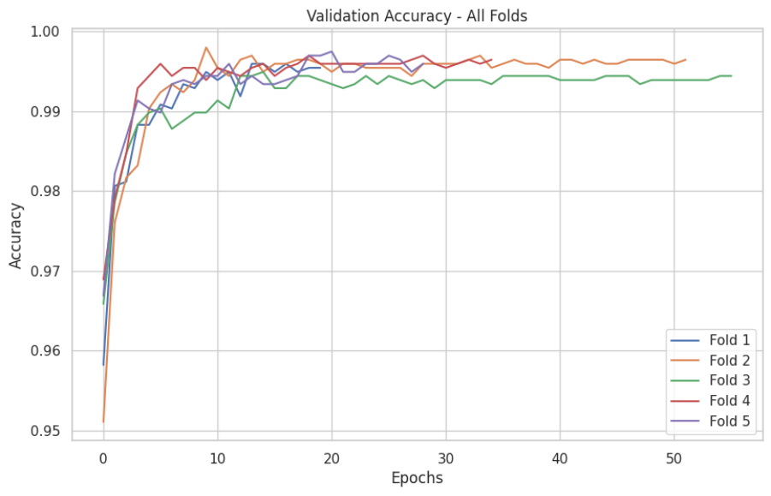
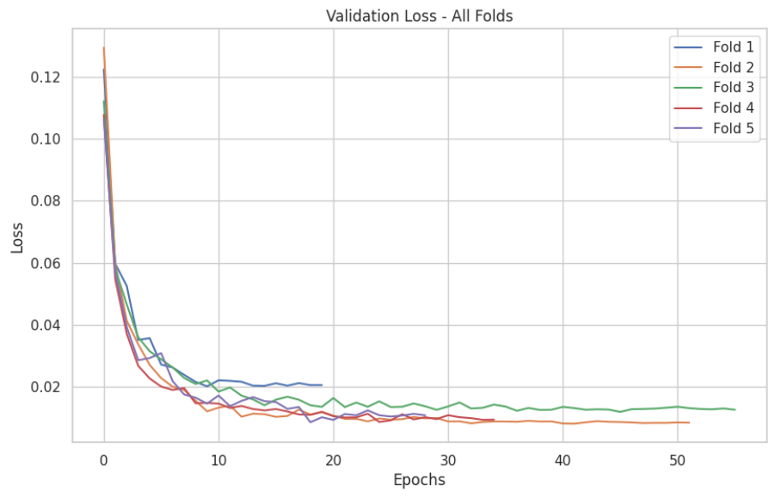
RESULTS
Fig 3. Validation Accuracy and Loss Curves Of All Folds for InceptionV3 with RMSprop Optimizer

Slide 17
IMPLEMENTATION &WORK DONE
Model 2 – ConvNeXt
1. Dataset Preparation
  Created a balanced subset (~4000 images: 2000 per class).
  Preprocessed images (resizing and cleaning).
2. Model Building
  Used ConvNeXtTiny (pre-trained on ImageNet) with a custom classification head.
  Input → ConvNeXt-Tiny (pre-trained) → Global Average Pooling → Batch Normalization → Dense(256, ReLU) → Dropout(0.4,0.5) → Output
  Fine-tuned last 20 layers for better domain-specific learning.
3. K-Fold Cross-Validation
  Applied 5-Fold Cross-Validation for robust evaluation.
  Used scikit-learn and ImageDataGenerator for splits.
4. Training & Hyperparameter Tuning
  Trained in 3 phases (25 epochs → 500 epochs → cleaned dataset).
  Tuned learning rates, optimizers, and used callbacks (EarlyStopping, ReduceLR on plateau.
5. Implementation Environment
  Used Google Colab with TensorFlow/Keras, scikit-learn, and Matplotlib.

Slide 18
RESULTS
Model: ConvNeXtTiny (pre-trained on ImageNet
Dataset: 4,000 images (lung_aca vs lung_scc)
Optimizer: Adam | Batch Size: 32 | Input Size: 224×224
Performance Progression:
Training Stage | Mean Val. Accuracy | Std. Dev.
Initial (25 Epochs, Frozen) | 89.97% | ±0.36%
Fine-Tuned (500 Epochs, 20 Layers) | 91.83% | ±1.63%
Extended (Frozen Layers, 500 Epochs) | 92.60% | ±0.77%
Cleaned Dataset (Frozen, 500 Epochs) | 93.02% | ±0.70%
Key Insight:
Accuracy consistently improved across training phases — from 89.97% → 93.02%, showing strong generalization and stability.

Slide 19
RESULTS
Training Pattern:
  Rapid learning in early epochs (~87–90%)
  Gradual fine-tuning from epochs 20–500
  Consistent validation loss decrease (no overfitting)
Learning Rate Strategy:
  Initial: 1×10⁻⁴ (or 3×10⁻⁵ for fine-tuning)
  Adaptive reduction (factor 0.3–0.5, patience 3–5)
Overall Observations:
  Fine-tuning & dataset cleaning improved accuracy and stability.
  Low variance across folds (≤1.63%) → reliable model behavior.

Slide 20
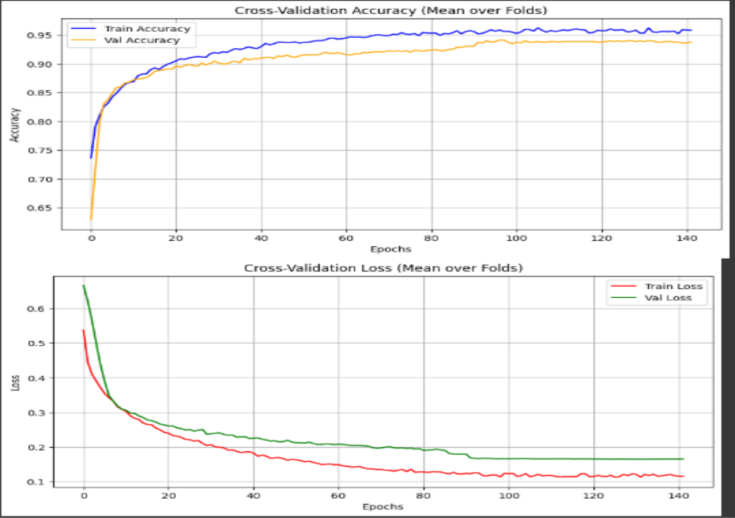
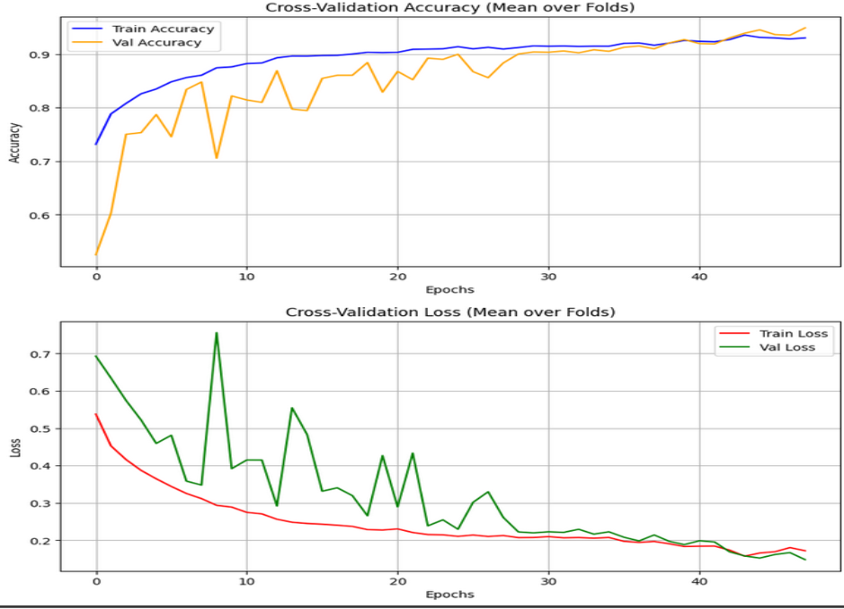
RESULTS
Training and validation accuracy and loss curves for ConvNeXtTiny.

Slide 21
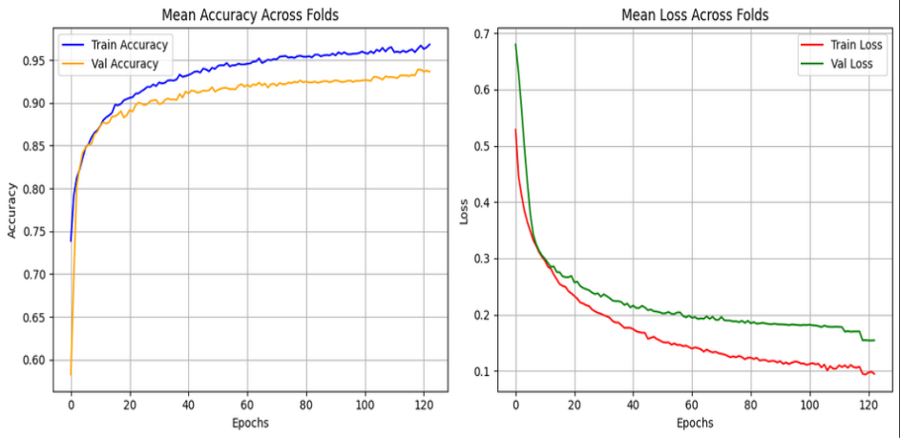
RESULTS

Slide 22
IMPLEMENTATION &WORK DONE
Densenet121 Model
Base Model: DenseNet121 (ImageNet weights, top removed, frozen layers).
Input: 224×224×3 RGB images.
Feature Extractor: Dense and transition blocks for deep feature learning.
Pooling: Global Average Pooling to flatten spatial features.
Batch Normalization: Stabilizes and accelerates training.
Dense Layer (512, ReLU): Learns complex feature interactions.
Dropout (0.5): Prevents overfitting.
Output Layer: Dense(1, Sigmoid) for binary classification (lung_aca, lung_scc).

Slide 23
IMPLEMENTATION &WORK DONE
DenseNet121 Implementation
Dataset: ~4,000 balanced images (lung_aca & lung_scc), resized to 224×224.
Model: DenseNet121 with custom classification head and dropout; progressively fine-tuned deeper layers for better feature adaptation.
Validation: 5-Fold Cross-Validation
Training: Training1 used Adam, Training2 used AdamW; learning rate from 1×10⁻⁴ to 1×10⁻¹² with callbacks for early stopping & ReduceLRnplateau
Environment: Google Colab with TensorFlow/Keras.

Slide 24
RESULTS
Training1 Configuration
Optimizer: Adam
Adaptive gradient algorithm combining momentum and RMSProp benefits.
Initial Learning Rate: 1×10⁻⁴ Minimum LR: 1×10⁻¹²
Balanced learning pace, gradually reduced during plateau phases.

Slide 25
RESULTS​
​
​
Training 1 Adam Optimizer
Training Stage | Description | Mean Validation Accuracy
Initial | DenseNet121 with frozen ImageNet weights trained only on top layers | 97.45%
Fine-Tuned | Partial unfreezing of deeper DenseNet layers to adapt features | 98.97% (Training1 – Adam)
Extended | Full layer unfreezing and optimized training with Adam | 99.10%

Slide 26
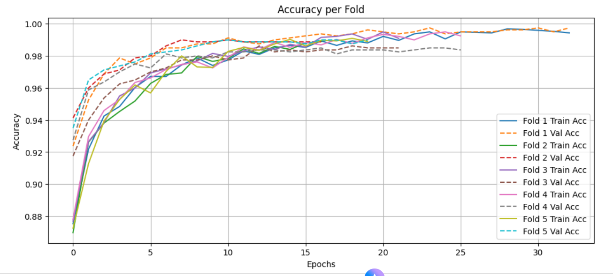

Slide 27
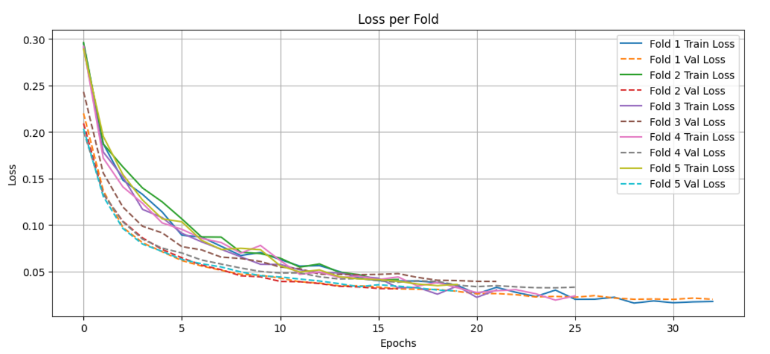

Slide 28
Training2 Configuration
Optimizer: Adamw
Training Stage | Description | Mean Validation Accuracy
Cleaned Dataset (AdamW Optimizer) | Training performed on cleaned dataset (reduced white patches in lung_aca) using AdamW for better weight decay and generalization | 99.75%
Final Fine-Tuned Stage | Full fine-tuning of DenseNet121 with learning rate scheduling and early stopping for stability | 99.75% (Training2 – AdamW)

Slide 29
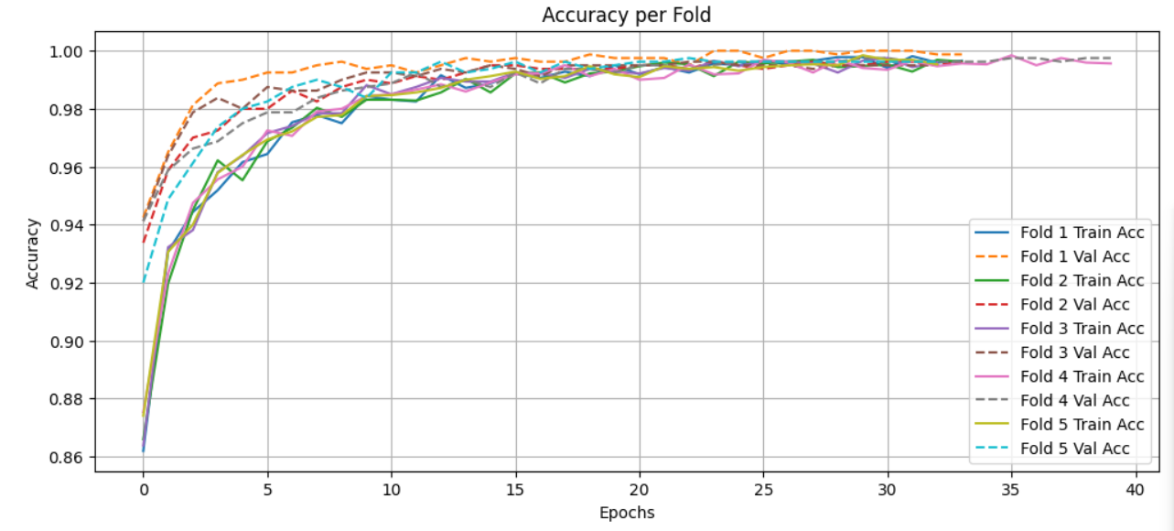

Slide 30
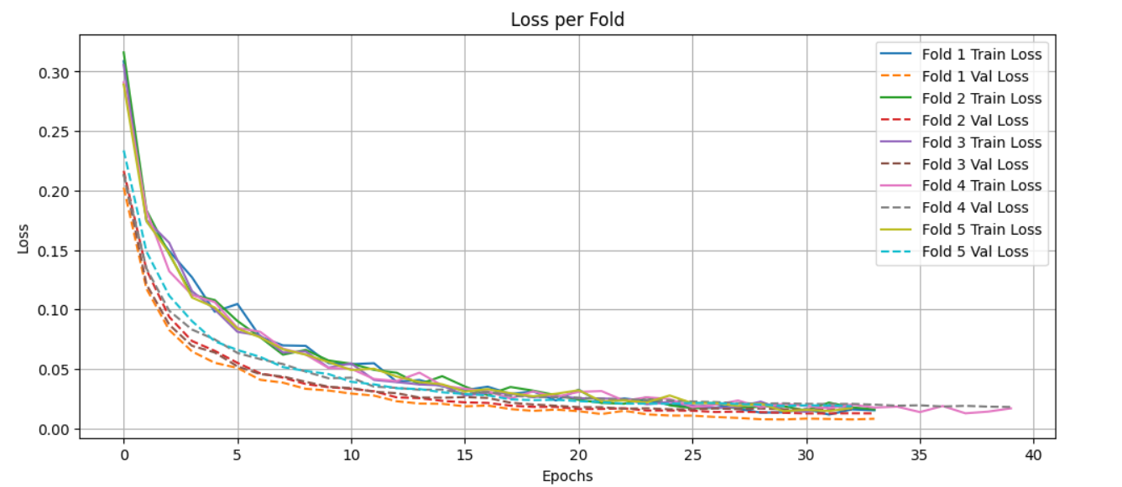

Slide 31
IMPLEMENTATION &WORK DONE
Model 4 – MobileNetV2
1.Dataset & Preprocessing
  LC25000: lung_aca & lung_scc
  Manual cleaning, resized 224x224, normalized
2.Model Architecture
  Pretrained MobileNetV2 (ImageNet)
  Global Avg Pooling→Dropout(0.4) → Dense(128, ReLU) + Dropout(0.4)→Sigmoid output
3.Training
Parameter
Batch size | 32
Epochs | 500 (max) , 139(early stopping)
Regularization | L2(0.01), dropout(0.4)
Learning rate | 1e-4
Min. LR | 1e-8
Callbacks | ReduceLROnPlateau, EarlyStopping

Slide 32
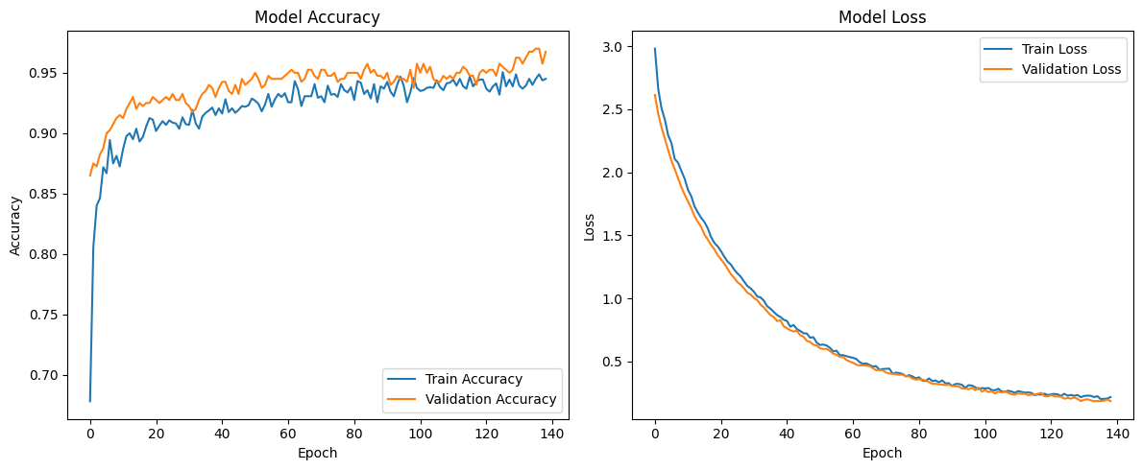
IMPLEMENTATION &WORK DONE
Accuracy:97%

Slide 33
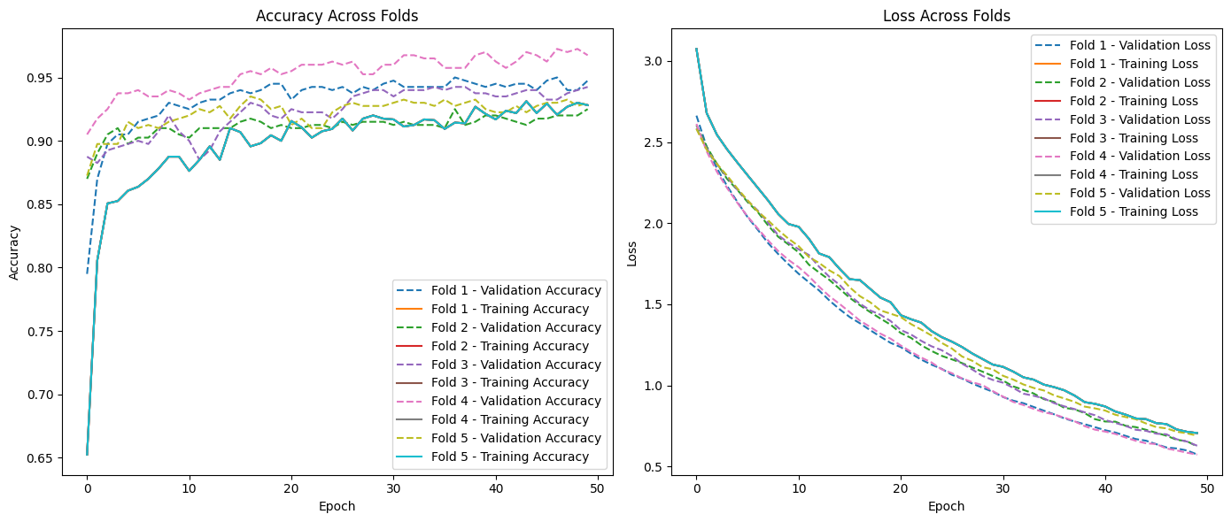
IMPLEMENTATION &WORK DONE
Mean Validation Accuracy Across All Folds: 92.85%

Slide 34
FURTHER WORK
Week | Tasks
Week 1–2 | Dataset Preparation and Model Training • Receive the main dataset from the college. • Preprocess images: resizing, normalization, augmentation as needed. • Train all four models for both classification and grading using 5-fold cross-validation on college GPU. • Track metrics: accuracy, AUC, confusion matrices, misclassification rates. • Apply learning rate schedules and early stopping to optimize training.
Week 3 | Performance Analysis and Visualization • Compare performance across models for classification and grading tasks. • Generate and finalize plots: accuracy/loss curves, ROC curves, confusion matrices, grading accuracy charts. • Apply Grad-CAM or similar explainability methods to visualize which image regions contribute most to model predictions.
Week 4 | Final Report and Presentation Preparation • Write the final report, including methodology, results, analysis, conclusions, and future work. • Prepare PowerPoint slides summarizing objectives, methodology, results, and conclusions. • Rehearse presentation for 13–14 Nov. • Preparing the Research Paper.

Slide 35
CONCLUSION
Good Performance: DenseNet121 with AdamW achieved 99.75% mean validation accuracy.
Reliable Classification: InceptionV3 reached 99.72% mean accuracy
ConvNeXt Stability: The ConvNeXtTiny model, utilizing its modern architectural design, Final Mean Validation Accuracy: 93.02%
MobileNetV2: Achieved accuracy of 97%. The model performed very well in distinguishing between the two types of lung images on the validation set.
Consistency: models showed fast convergence, low variance, and strong generalization across 5-fold CV.

Slide 36
REFERENCES
P. Patharia and P. K. Sethy, “LungCarcinoGrade-EffNetSVM: A Novel Approach to Lung Carcinoma Grading using EfficientNetB0 and Support Vector Machine,” in Proc. 8th Int. Conf. I-SMAC – IoT in Social, Mobile, Analytics and Cloud, IEEE, 2024.
A. S. N. Raju, K. Venkatesh, R. K. Gatla, E. P. Konakalla, M. M. Eid, N. Titova, S. S. M. Ghoneim, and R. N. R. Ghaly, “Colorectal cancer detection with enhanced precision using a hybrid supervised and unsupervised learning approach,” Scientific Reports, vol. 15, no. 1, pp. 1–14, Jan. 2025.
S.-Y. Park, G. Ayana, and S.-w. Choe, “Squamous Cell Carcinoma Margin Classification Using Vision Transformers from Digital Histopathology Images,” in Proc. 2025 Int. Conf. Artificial Intelligence in Information and Communication (ICAIIC), IEEE, 2025.
C. Yang, X. Yu, H. Yang, Z. An, C. Yu, L. Huang, and Y. Xu, “Multi-Teacher Knowledge Distillation with Reinforcement Learning for Visual Recognition,” in AAAI 2025 (Oral Presentation), 2025.
Z. Kang, M. Chen, H. Zhang, and X. Liao, “EsccNet: A Hybrid CNN and Transformers Model for Classification of Whole Slide Images of Esophageal SCC.”

Slide 37
THANK YOU

Slide 38
FUNCTIONAL REQUIREMENTS
1. Image Data Preprocessing
  Load and Preprocess LC25000 histopathology images
    Resize images to 224x224 pixels
    Normalize pixel values to the range [0, 1]
    Apply data augmentation techniques (rotation, flipping, zoom, brightness)
2. Model Training
  Train Multiple Deep Learning Models for binary classification
    Utilize models like DenseNet, ConvNeXt, EfficientNetB3, InceptionV3
    Implement Hyperparameter Tuning (learning rates, batch sizes, optimizers)
3. Evaluation and Metrics
  Evaluate Models with standard metrics
    Accuracy, Precision, Recall (Sensitivity), F1-score
    Confusion Matrix for class-wise performance
4. Visualization of Results
  Visualize results with:
    Performance plots (Accuracy, Loss)
    Confusion Matrices
    Training curves for comparison

